Slide 1
3
Chapter
Foundations
of Decision
Making
Copyright ©2011 Pearson Education

Slide 2
Individual Decision Making
typically described in an extremely simplistic way as “choosing among alternatives”.
Recognize and
define problem
Search for
information
Generate
alternatives
Evaluate and
choose
alternative
Implement
choice
Evaluate
outcome

Slide 3
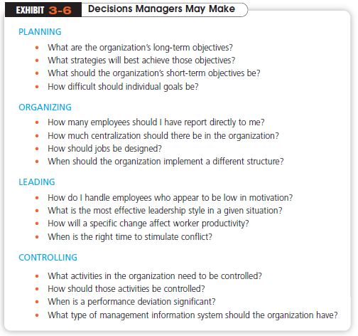

Slide 4
How Do Managers Make Decisions?
Problem
  A discrepancy between an existing and a desired state of affairs
Decision Criteria
  Factors that are relevant in a decision
Decision-Making Process
  A set of eight steps that includes identifying a problem, selecting a solution, and evaluating the effectiveness of the solution
Copyright ©2011 Pearson Education, Inc. publishing as Prentice Hall

Slide 5
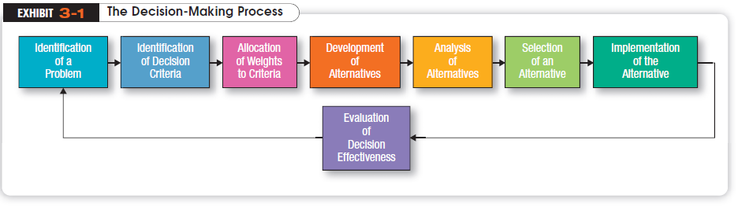
Copyright ©2011 Pearson Education

Slide 6
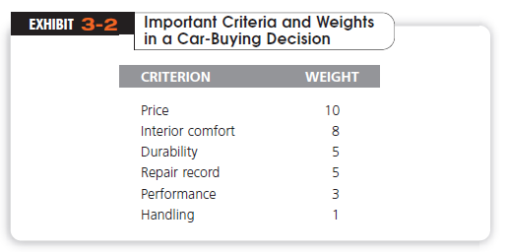
It’s necessary to allocate weights to the items listed in step 2 in order to give them their relative priority in the decision (step 3).
Copyright ©2011 Pearson Education

Slide 7
Managers are “decision makers.”
Managerial decision-making is assumed to be rational.
  Managers make consistent, value-maximizing choices within specified constraints.
Decision maker who was perfectly rational would be fully objective and logical.
  carefully define the problem and have a clear and specific goal.
  the steps in the decision-making process would consistently lead to selecting the alternative that maximizes that goal.
  decisions are made in the best interests of the organization.

Slide 8
Then the decision maker lists the alternatives that could succeed in resolving the problem (step 4).
Once the alternatives have been identified, the decision maker must critically analyze each one (step 5).
and only then select an alternative (step 6).

Slide 9
Decision Implementation
Although the choice process is completed in the previous step, the decision may still fail if it is not implemented properly (step 7).
Putting a decision into action; includes conveying the decision to the persons who will be affected by it and getting their commitment to it.
In the last step in the decision-making process (step 8) managers appraise the result of the decision to see whether it has corrected the problem.

Slide 10
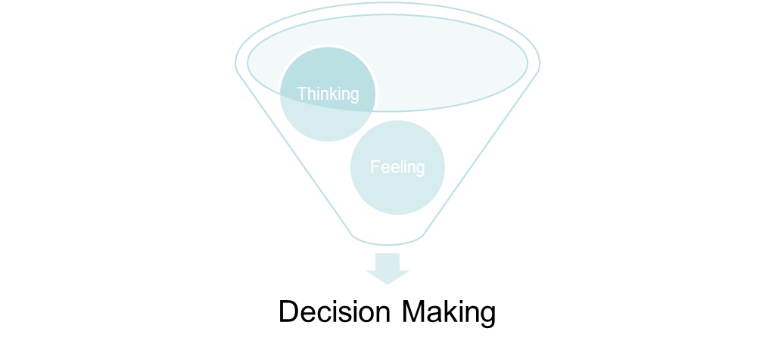
Do Emotions Make Us Irrational?
Emotions can aid in our decision-making process.
Many research have shown that emotions are necessary for rational thinking and to make better decisions.
Notes:
(c) 2008 Prentice-Hall, All rights reserved.

Slide 11
Life is full of decisions and choices.
The real question is not “To be, or not to be,” but rather “To do, or not to do?” For example should I confront my professor about my midterm grade? Should I buy a new car? Should I accept a new job? Should I choose this major? Very often we are unsure of our decision.
Chances are you’ll regret inaction, more than action. Research shows that once a decision has been made, inaction is regretted more than action. Although we often regret actions in their immediate aftermath, over time regrets over actions decline markedly, whereas regrets over missed opportunities increase.
When in Doubt, Do!

Slide 12
Common Errors in the D-M Process
Heuristics
  “rules of thumb” to simplify decision making
  May lead to errors and biases
    Overconfidence Bias
      thinking they know more than they do or hold unrealistically positive views of themselves and their performance.
    Immediate gratification bias
      describes decision makers who tend to want immediate rewards and to avoid immediate costs.
    Anchoring effect
      when decision makers fixate on initial information and then, once set, fail to adequately adjust for subsequent information.

Slide 13
Common Errors in the D-M Process
    Selective perception bias
        decision makers selectively organize and interpret events based on their biased perceptions.
    Confirmation bias
        decision makers who seek out information that reaffirms their past choices and discount information that contradicts past judgments
    Framing bias
        when decision makers select and highlight certain aspects of a situation while excluding others.
    Availability bias
        is when decisions makers tend to remember events that are the most recent and vivid in their memory.

Slide 14
    representation bias
        when decision makers assess the likelihood of an event based on how closely it resembles other events or sets of events.
    randomness bias
        describes when decision makers try to create meaning out of random events.
    sunk costs error
        when decision makers forget that current choices can’t correct the past.
    self-serving bias
        decision makers who are quick to take credit for their successes and to blame failure on outside factors.
    hindsight bias
        the tendency for decision makers to falsely believe that they would have accurately predicted the outcome of an event once that outcome is actually known.

Slide 15
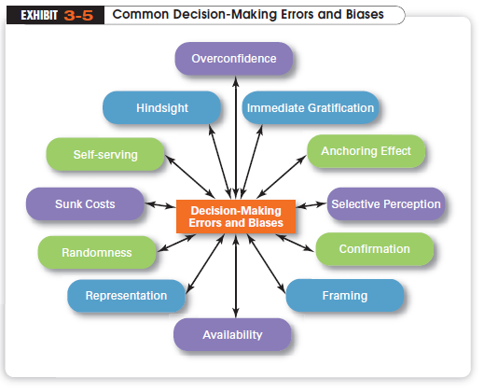

Slide 16
What is the Rational Model of D-M?
Rational Model assumes
  that managers’ decision making will be rational logical and consistent choices to maximize value
  The problem faced would be clear and unambiguous
  the decision maker would have a clear and specific goal
  know all possible alternatives and consequences

Slide 17
What is Bounded Rationality?
Realistically, managers are limited (bounded) in their ability to process information.
Because managers can’t analyze information on all alternatives, they satisfice or accept solutions that are “good enough” rather than maximize.

Slide 18
Decision Making Models’ Comparsion
 | Rational Decision Making | Boundedly Rational Decision Making
Desired Outcome | Optimal solution | Satisficing solution
Degree of Information | Complete | Partial or filtered
Appropriate Environment | Stable or high costs from failure | Unstable or need for quick action
Resources Required | High | Low to moderate

Slide 19
What Role Does Intuition Play in Managerial Decision Making?
Intuitive Decision Making
  making decisions on the basis of experience, feelings and accumulated judgment
  described as “unconscious reasoning.”
  can complement both bounded rationality and rational decision making.
  a manager who has had experience with a similar type of problem or situation often can act quickly with what appears to be limited information because of that past experience.

Slide 20
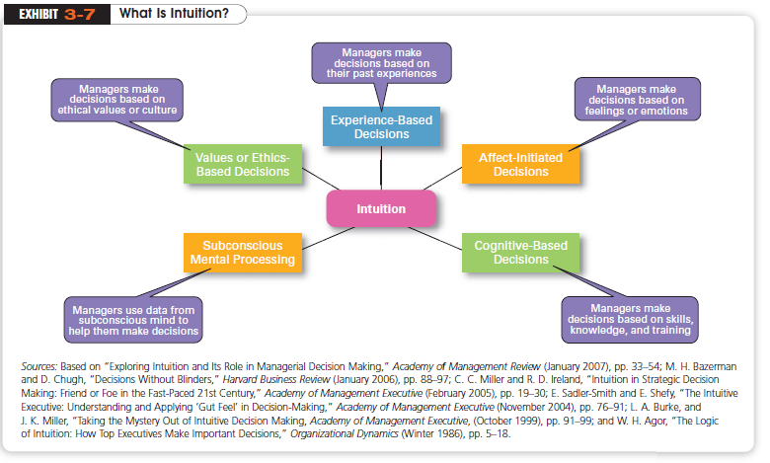

Slide 21
How Do Problems Differ?
Structured Problem
  A straightforward, familiar, and easily defined problem
  Examples might include a supplier’s tardiness with an important delivery, a customer’s wanting to return an Internet purchase, etc.
Unstructured Problem
  A problem that is new or unusual for which
  information is ambiguous or incomplete.

Slide 22
What Are Programmed and Nonprogrammed Decisions?
Programmed Decisions
  A repetitive decision that can be handled using a routine approach
Nonprogrammed Decisions
  A unique and nonrecurring decision that requires a custom-made or unique solution.

Slide 23
Programmed D-M Aids
Policy
  A general guide that establishes parameters for making decisions about recurring problems.
Procedure
  A series of interrelated sequential steps that can be used to respond to a well-structured problem (policy implementation).
Rule
  An explicit statement that tells managers what they ought or ought not to do (limits on procedural actions).

Slide 24
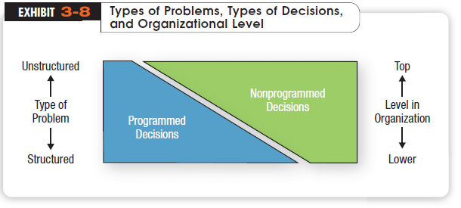

Slide 25
What Decision Making Conditions Do Managers Face?
Certainty
  A situation in which a decision maker can make accurate decisions because all outcomes are known
Uncertainty
  A situation in which a decision maker has neither certainty nor reasonable probability estimates available
Risk
  A situation in which a decision maker is able to estimate the likelihood of certain outcomes

Slide 26
Can manager’s decision making Job making be improved with technology?
Expert systems use software programs to encode the relevant experience of an expert and allow a system to act like that expert in analyzing ill-structured problems.
  Use specialized knowledge about a particular problem area rather than general knowledge that would apply to all problems.
  Use qualitative reasoning rather than numerical calculations.
  Perform at a level of competence that is higher than that of non-expert humans.
Neural networks are the next step beyond expert systems.
  Use computer software to imitate the structure of brain cells and connections among them.
  People can’t easily assimilate more than two or three variables at once, but neural networks can perceive correlations among hundreds of variables.
  Example, most banks today use neural networks to check potential credit decisions and flag majority of credit card transaction fraud.

Slide 27
Hofstede’s Framework for Assessing Cultures
Individualism
versus
Collectivism
Long-Term
versus
Short-Term Orientation
Power
Distance
Culture
Achievement versus Nurturing
Uncertainty
Avoidance

Slide 28
Managerial Decisions Affected by Culture
Planning
  The degree of risk that plans should contain
  Whether plans should be developed by individuals or teams
  The degree of environmental scanning in which management will engage
Organizing
  How much autonomy should be designed into employees’ jobs
  Whether tasks should be done by individuals or in teams
  The degree to which department managers interact with each other

Slide 29
Managerial Decisions Affected by Culture (cont’d)
Leading
  The degree to which managers are concerned with increasing employee job satisfaction
  What leadership styles are appropriate
  Whether all disagreements—even constructive ones—should be eliminated
Controlling
  Whether to impose external controls or to allow employees to control their own actions
  What criteria should be emphasized in employee performance evaluations
  What repercussions will occur from exceeding one’s budget

Slide 30
National culture affects D-M
Research shows that, to some extent, decision-making practices differ by country.
Two decision variables.
      The way decisions are made: Who makes the decision?
      The degree of risk a decision maker is willing to take.
Turkey → power distance and uncertainty avoidance are high.
      Only very senior-level managers make decisions, and they are likely to make safe ones; where time pressures are low, managers make decisions at a slower and more deliberate pace
Sweden, power distance and uncertainty avoidance are low.
      Swedish senior managers tend not to be afraid to make risky decisions and also push decisions down in the ranks.

Slide 31
Managerial styles in Germany often reflect the German culture’s concern for structure and order
    extensive rules and regulations, and managers accept that decisions that go through formalized channels.
France, autocratic decision making is widely practiced, and managers avoid risks.
Japanese consensus-forming group decisions.
    Japanese CEOs collect a large amount of information, to build consensus, called “ringisei.”
    Managerial decisions take a long-term perspective

Slide 32
To Sum Up..
Rational decision making is a model to describe how decisions should be made
Involves careful and complete evaluation of causes, alternatives & consequences
BUT….
We have limited information and processing capability!
Consequences of actions not certain and predictable.
How do we really make decisions?

Slide 33
What Contemporary D-M Issues Do Managers Face?
Creativity
  The ability to produce novel and useful ideas
      Different from what’s been done before and appropriate to the problem or opportunity presented.
  allows the decision maker to appraise and understand the problem more fully, including “seeing” problems other can’t see.
  most obvious value is in helping the decision maker identify all viable alternatives.

Slide 34
Elements of a Learning Organization
Team-Based Structure
Learning Organization
Empowered Employees
Open Information

Slide 35
When Are Groups Most Effective?
Groups are more effective for decisions requiring
  Accuracy
  Creativity
  Acceptance
Ideal Group Size
  5 - 7 (max. 15)
  The larger the group, the greater the opportunity for heterogeneous representation
Copyright ©2011 Pearson Education

Slide 36
Group Decision Making
Advantages
  Group decisions provide more complete information
  Diversity of experiences and perspectives are higher
  Groups generate more alternatives
  Group decisions increase acceptance of a solution
Disadvantages
  Group decisions are time consuming
  May be subject to minority domination
  Subject to pressure to conform
  Responsibility is ambiguous
  Subject to Groupthink which undermines critical thinking
Notes:
Individual and group decisions have their own set of strengths. Neither is ideal for all
situations.

Slide 37
How Can You Improve Group Decision Making?
Electronic Meeting (e.g. videoconferencing)
  participants are linked by computer; individual comments and voting results are projected. Faster, cheaper, geographical boundaries..

Slide 38
Brainstorming
  an idea-generating process that encourages alternatives while truly withholding criticism
Nominal Group Technique
  group members operate independently on their list and «secretly» rank-orders the ideas, which are presented by taking turns
  works by restricting lengthy discussion during the decision-making process, open room for independent thinking.

